Slide 1
Frontiers Data

Slide 2
frontiers
Founded | 2007; 18 years ago
Founder | Kamila Markram and Henry Markram
Country of origin | Switzerland
Headquarters location | Lausanne
Publication types | Open access scientific journals
Nonfiction topics | Medicine, life sciences, technology
No. of employees | >1,400 (2022)^{[1]}
Official website | www.frontiersin.org

Slide 3
Mission
Frontiers’ mission is to make science open – so that scientists can collaborate better and innovate faster to deliver the solutions that enable healthy lives on a healthy planet.
Research is the foundation of modern society and it’s thanks to advances in science that we enjoy longer, healthier and more prosperous lives than ever before in human history. We want to make science even more powerful by ensuring it is openly available. This way, society will be able to generate more knowledge and accelerate innovation, health and prosperity for all.

Slide 4
#1 Europe is the world’s leading market
GNP 2005 in US dollars (in billions)
14 000
13,328.7
12,487.2
12 000
10 000
EU-25
8 000
USA
6 000
4,567.7
Japan
4 000
China
2,225.7
2 000
0
EU-25
USA
Japan
China
Data source: Chief economic indicators from the OECD. Domestic data source from IMD

Slide 5
#2 France - an influential economy at the heart of the EU
GNP 2005 in Euros (in billions)
3000
2500
2,417.9
2,092.4
1,929.1
2000
1,581.9
1500
1,110.8
1000
582.6
500
340.6
343.7
317
311.5
0
France
Italy
Sweden
Switzerland
Germany
United Kingdom
Spain
Netherlands
Belgium
Poland
Data source: Eurostat, 2006

Slide 6
#3 France - leading tourist destination in the world
Flux of tourist entry in 2004 (in millions)
80
75.1
70
60
52.4
50
46.1
41.8
40
37.1
30
27.8
20.6
20.1
19.9
19.4
20
10
0
France
China
Italy
Mexico
Austria
Spain
USA
United Kingdom
Germany
Russia (fed.)
Data source: World Tourism Organization, 2006

Slide 7
#4 A highly educated workforce
Percentage of the population (aged 20 to 29)
with a university degree in science & technology
(2004 or last publication)
25
23.1
22
20
18.1
17.4
15.9
15
13.8
12.5
11.2
10.2
10
5
0
Ireland
France
Finland
Sweden
Denmark
Spain
Belgium
USA
United Kingdom
Data source: Eurostat, 2005

Slide 8
#5 A productive workforce
Annual production per employee
(Base 100 : EU-25, on average 2002-2005)
European Union
at 25 (100)
140
120
100
80
60
40
20
0
France
Italy
Netherlands
Japan
Poland
USA
Belgium
United Kingdom
Germany
Spain
Data source: Eurostat

Slide 9
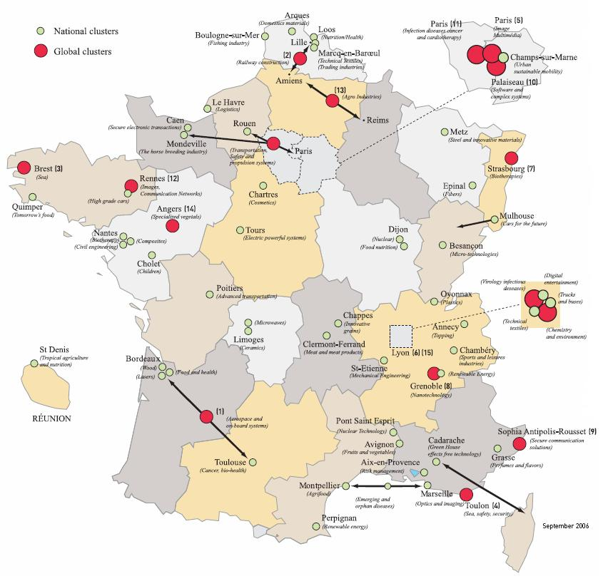
#6 Clusters, the new economic map

Slide 10
#7 Paris, the headquarters hot spot
Best European capitals to set up a company
1
0.91
0,9
0,8
0,7
0.59
0,6
0,5
0.36
0,4
0.27
0.24
0.23
0,3
0.2
0.18
0.18
0.16
0,2
0,1
0
London
Paris
Frankfurt
Madrid
Berlin
Munich
Zürich
Barcelona
Bruxelles
Amsterdam
Data source: Cushman & Wakefield, 2006. Results from an opinion poll obtained from chief executives.
Rating: from 0 to 1

Slide 11
#8 Production costs lower than its neighbors
Cost advantages for a medium-size production site,
in comparison to the USA.
8,00%
6,00%
5.50%
4.40%
4.30%
4,00%
2.20%
1.90%
2,00%
0
0%
0,00%
Canada
France
Netherlands
Italy
United
USA
Japan
Germany
-2,00%
Kingdom
-4,00%
-6,00%
-8,00%
-6.90%
-7.40%
-10,00%
Data source: KPMG, 2006.
General index corresponding to a sample of production sites (manufacturing and assembling lines)

Slide 12
#9 Top-tier infrastructure
High speed railways: in km, per million of habitants (2005)
30
26
25
22
20
18
15
15
11
10
4
5
1
0
0
0
0
France
Japan
Italy
Netherlands
Poland
Spain
Germany
Belgium
United Kingdom
USA
Data source: UIC - February 2006

Slide 13
#10 A new framework to help businesses
Number of days required to set up a new company (in 2005)
50
47
45
40
31
31
34
35
30
24
Number of days
25
18
20
13
15
8
11
10
5
5
0
France
Italy
Kingdom
Japan
Netherlands
Poland
Belgium
USA
Germany
Spain
United
Data source: Doing Business Report 2006 (SFI, World Bank Group)

Slide 14
CONCLUSION Foreign companies give France Two Thumbs Up
Number of international ventures per destination in Europe (in 2005)
600
559
538
500
400
300
200
181
180
180
147
116
115
111
96
100
0
France
Poland
Belgium
Spain
Hungary
Russia
Sweden
United Kingdom
Germany
Czech. Republic
Data source: Ernst and Young, 2006

Slide 15
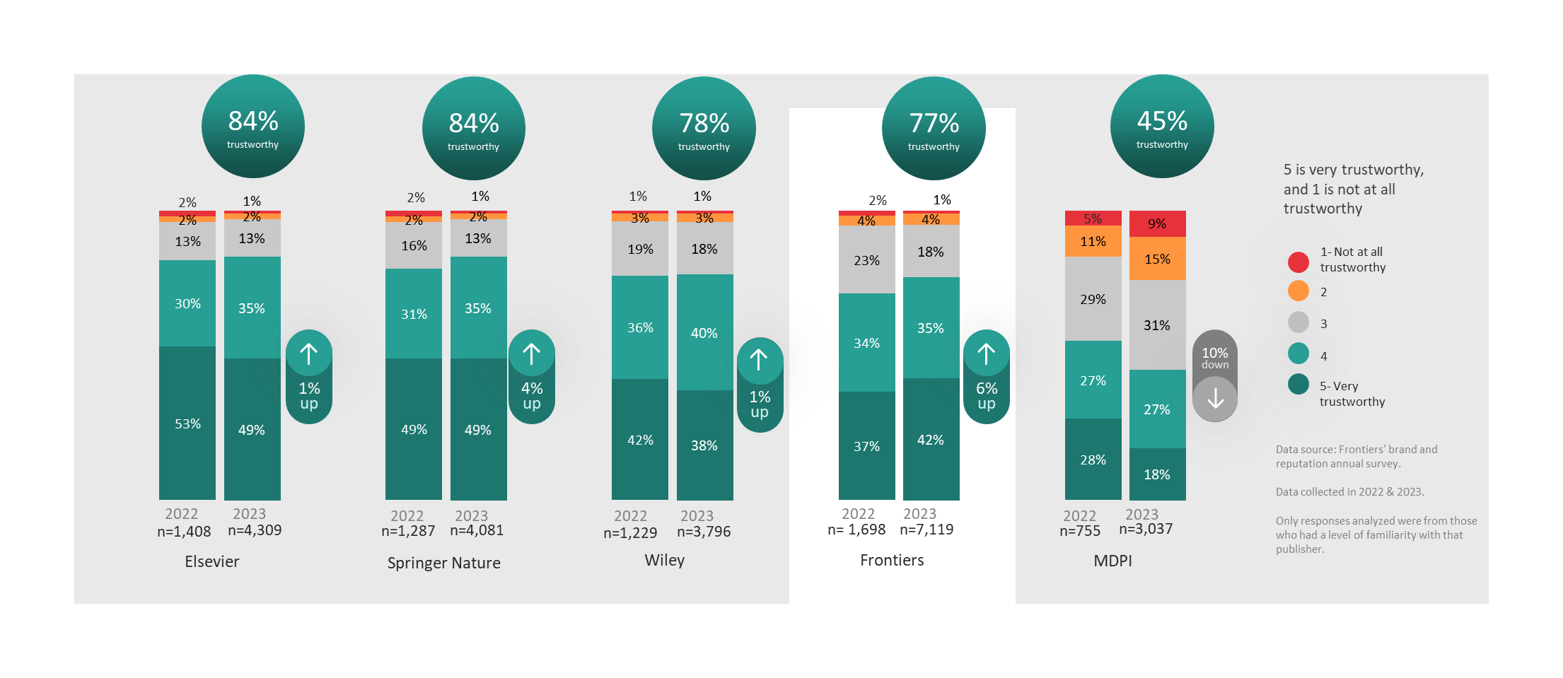
Overall trustworthiness
77% of respondents think Frontiers is trustworthy, a 6% increase from 2022. Frontiers has trust scores comparable to the biggest brands.
How would you rate the overall trustworthiness of this publisher?
Showing all responses from those familiar with the publisher.

Slide 16
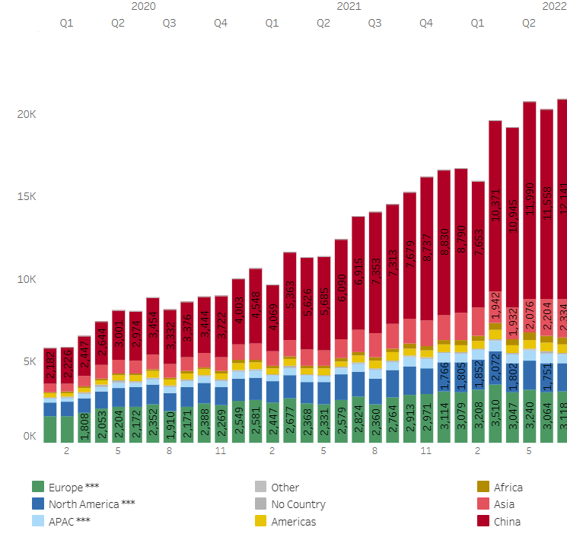
Confirmed Contributors

Slide 17
Module 3: Learning Objectives
Understand different ways to best summarize data
Choose the right table/graph for the right data
Interpret data to consider the programmatic relevance
Notes:
In this session, the learner will:
Note to facilitator: Read slide.

Slide 18
Summarizing data
Tables
Simplest way to summarize data
Data are presented as absolute numbers or percentages
Charts and graphs
Visual representation of data
Data are presented as absolute numbers or percentages
Notes:
The two main ways of summarizing data are by using tables and charts or graphs.
A table is the simplest way of summarizing a set of observations. A table has rows and columns containing data, which can be in the form of absolute numbers or percentages, or both.
Charts and graphs are visual representations of numerical data and, if well designed, will convey the general patterns of the data.

Slide 19
Basic guidance when summarizing data
Ensure graphic has a title
Label the components of your graphic
Indicate source of data with date
Provide number of observations (n=xx) as a reference point
Add footnote if more information is needed
Notes:
To make your graphics as self-explanatory as possible, there are several things to always include:
Every table or graph should have a title or heading
The x- and y-axes of a graph should be labeled – include value labels, such as a percentage sign; include a legend
Always cite the source of your data and put the date of data were collection or publication
Provide the sample size or the number of people to which the graph is referring (N)
Include a footnote if the graphic isn’t self-explanatory
These points will pre-empt questions and explain the data. In the next several slides, we’ll see examples of these points.

Slide 20
Tables: Frequency distribution
Set of categories with numerical counts
Year | Number of births
1900 | 61
1901 | 58
1902 | 75
Notes:
Let’s start with tables. Most tables show a frequency distribution, which is a set of categories with numerical counts. Here, you see the year as the category and the number of births as the numerical count.
What should be added to this table to provide the reader with more information?
Note to facilitator: Wait for a participant response before answering.
Answer – Title
Answer – Data source

Slide 21
Tables: Relative frequency
number of values within an interval
total number of values in the table
x 100
Year | # births (n) | Relative frequency (%)
1900–1909 | 35 | 27
1910–1919 | 46 | 34
1920–1929 | 51 | 39
Total | 132 | 100.0
Notes:
Another common way to summarize data is with relative frequency – which is the percentage of the total number of observations that appear in that interval.
It is computed by dividing the number of values within an interval by the total number of values in the table, then multiplying by 100 to get the percentage.
In this table, you see the proportion of the total number of births between 1990 and 1929 (132) by 10-year intervals.
The calculation for the first relative frequency is: 35/132 = 0.265 x 100 = 26.5 (approx 27%).

Slide 22
Tables
Percentage of births by decade between 1900 and 1929
Year | Number of births (n) | Relative frequency (%)
1900–1909 | 35 | 27
1910–1919 | 46 | 34
1920–1929 | 51 | 39
Total | 132 | 100.0
Source: U.S. Census data, 1900–1929.
Notes:
To interpret this table, we should look at the relative frequencies. What do they tell us?
We can see data across the three decades and what percentage of births occurred in each one. The largest percentage of children were born between 1920 and 1929, compared to the other two decades.
We can interpret the data further by calculating the average or the mean number of births across 30 years. This will give us a summary of the data.

Slide 23
Charts and graphs
Charts and graphs are used to portray:
Trends, relationships, and comparisons
The most informative are simple and self-explanatory
Notes:
Although they are easier to read than tables, charts provide less detail. The loss of detail may be replaced by a better understanding of the data.

Slide 24
Use the right type of graphic
Charts and graphs
Bar chart: comparisons, categories of data
Line graph: display trends over time
Pie chart: show percentages or proportional share
Notes:
We’re going to review the most commonly used charts and graphs in Excel/PowerPoint. Later, we’ll have you use data to create your own graphics, which may go beyond those presented here.
Bar charts are used to compare data across categories.
Line graphs are used to display trends over time.
Pie charts show percentages or the contribution of each value to a total.

Slide 25
Bar chart Comparing categories
Notes:
In this bar chart, we’re comparing the categories of data, which are the different sites. You see a comparison between sites by quarters and between quarters over time.
What should be added to this chart to provide the reader with more information?
NOTE to facilitator: Wait for a participant response before answering (and then show next slide).
On the next slide, we see how the graph has been improved and is now self-explanatory.

Slide 26
Percentage of new enrollees tested for HIV at each site, by quarter
Q1 Jan–Mar
Q2 Apr–June
Q3 July–Sept
Q4 Oct–Dec
Data Source: Program records, AIDS Relief, January 2009 – December 2009.rce: Quarterly Country Summary: Nigeria, 2008
Notes:
You see we’ve added a title. By adding a title, you know the population to which the graph is referring.
We’ve added labels for each axis. Labeling the y-axis (vertical) was critical because now we know that the values are percentages rather than absolute numbers.
We’ve added the source of the data – this let’s us know from where the data are derived and where to find additional information about this topic.
And we’ve clarified the quarters with months.

Slide 27
Has the program met its goal?
Percentage of new enrollees tested for HIV at each site, by quarter
Target
Data Source: Program records, AIDS Relief, January 2009 – December 2009.. quarterly Country Summary: Nigeria, 2008
Notes:
Now let’s interpret this chart.
You will note that we have added the target for the number of new enrollees tested for HIV.
The target is to test 50% of new enrollees at each site in each quarter.
We see that sites 1 & 3 have met their targets, but that site 2 has not; it is at 30% new enrollees tested. What percentage of the target has this site met?
NOTE to facilitator: Wait for a participant response before answering.
30/50 = 0.6 or 60%

Slide 28
Stacked bar chart Represent components of whole & compare wholes
Number of Months Female and Male Patients Have Been
Enrolled in HIV Care, by Age Group
Number of months patients have been enrolled in HIV care
Data source: AIDSRelief program records January 2009 - 20011
Notes:
A stacked bar chart is often used to represent components of a whole and compare the wholes (or multiple values).
Here, you see the number of months female and male patients have been enrolled in HIV care, by age group. By looking within each bar, you see the age breakdown by gender, and by looking at both bars together, you can compare the number of months enrolled for both males and females.

Slide 29
Line graph
Displays trends over time
Number of Clinicians Working in Each Clinic During Years 1–4*
*Includes doctors and nurses
Notes:
A line graph should be used to display trends over time. While bar charts also are useful for showing time trends, line graphs are particularly useful when there are many data points. In this case, we have four data points for each clinic.
Here, you see the number of clinicians working in each clinic during years 1–4. You will note the asterisk in the title. This asterisk clarifies the definition of clinical to include both doctors and nurses.
What can be added to this graph to make it more clear? NOTE to facilitator: Wait for a participant response before answering. After someone participates, go to next slide.

Slide 30
Line graph
Number of Clinicians Working in Each Clinic During Years 1-4*
Y1 1995
Y2 1996
Y3 1997
Y4 1998
Zambia Service Provision Assessment, 2007.
*Includes doctors and nurses
Notes:
Data source is added and the actual years are defined.

Slide 31
Pie chart Contribution to the total = 100%
N=150
Notes:
A pie chart displays the contribution of each value to the total. In pie charts, the values always add up to 100.
In this case, we used the chart to show the contribution of patients enrolled each quarter to the total enrollment for the year. For example, the first quarter contributed the largest percentage (59%) of enrolled patients.

Slide 32
Interpreting data
Notes:
Once we have transformed data into information by summarizing them with tables, graphs, or narrative, we need to interpret the data. That is, we need to consider the relevance of the findings to our program – the potential reasons for the findings – and possible next steps.
In this process, we move from the ‘what’ is happening in our programs to the ‘why’ it is happening.

Slide 33
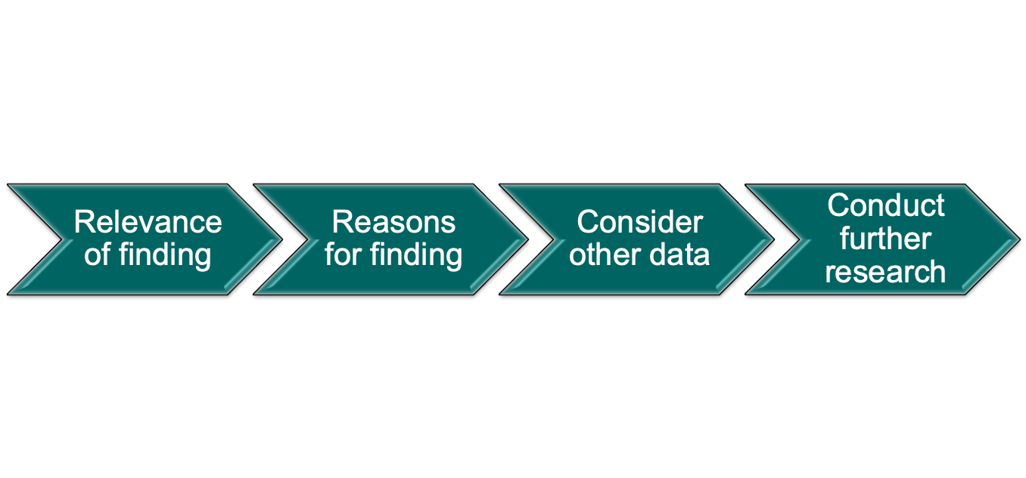
Interpreting data
Adding meaning to information by making connections and comparisons and exploring causes and consequences
Notes:
Data interpretation is the process of making sense of the information. It allows us to ask: What does this information tell me about the program?
Here, you see a flow chart of the steps involved in interpreting data …
NOTE to facilitator: Read the steps outlined in the diagram.

Slide 34
Interpretation – relevance of finding
Adding meaning to information by making connections and comparisons and exploring causes and consequences
Notes:
We start by wanting to know the relevance of our findings. Seeking the relevance of a finding is to:
NOTE to facilitator: Read slide.

Slide 35
Interpretation – relevance of finding
Does the indicator meet the target?
How far from the target is it?
How does it compare (to other time periods, other facilities)?
Are there any extreme highs and lows in the data?
Notes:
When interpreting data and seeking the relevance of our findings, we may ask these questions:
NOTE to facilitator: Read slide.
Asking these questions will help you to put the data in the context of your program.

Slide 36
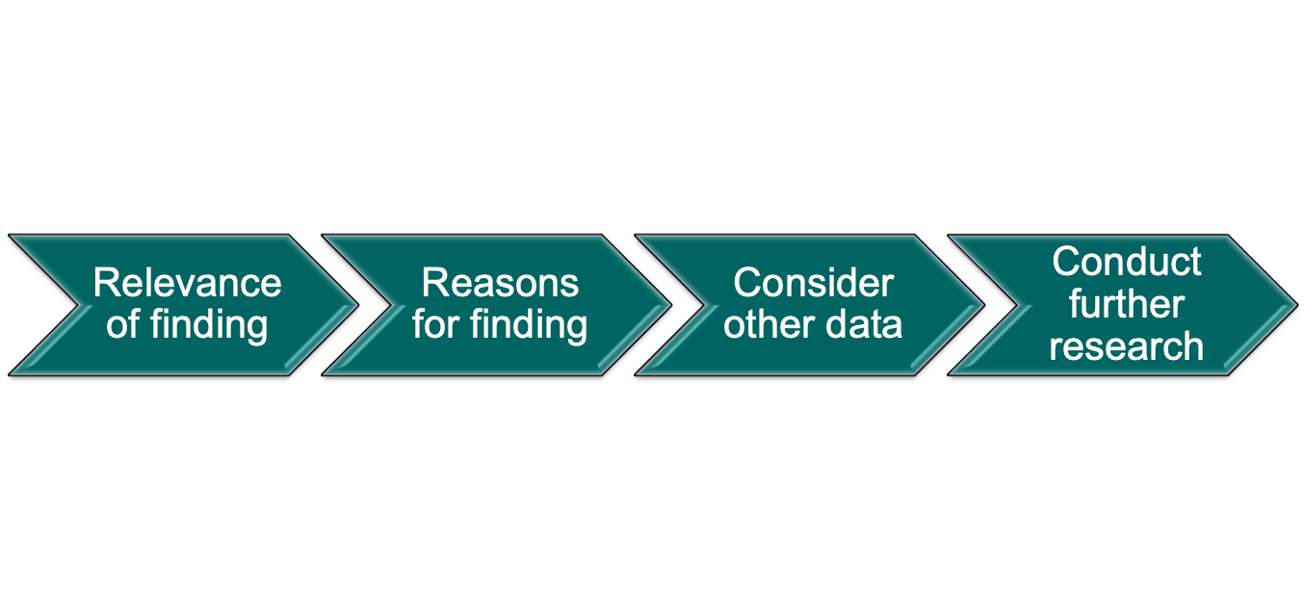
Interpretation – possible causes?
Supplement with expert opinion
Others with knowledge of the program or target population
Notes:
When seeking potential reasons for the finding, we often will need additional information that will put our findings into the context of the program.
Supplementing the findings with expert opinion is a good way to do this. For example, talk to others with knowledge of the program or target population, who have in-depth knowledge about the subject matter, and get their opinions about possible causes.
For example, if your data show that you have not met your targets, you may want to know if:
the community is aware of the service? To answer this, you could talk to community leaders or other providers to get their opinions.
Sometimes ad hoc conversations with experts are insufficient. To get a more accurate explanation of your findings, you often will have to consider other data resources.

Slide 37
Interpretation – consider other data
Use routine service data to clarify questions
Calculate nurse-to-client ratio, review commodities data against client load, etc.
Use other data sources
Notes:
Let’s go back to the finding of ‘the program has not met its annual target’. Can we understand why this is happening by looking at other program indicators?
You may want to calculate the nurse-to-client ratio to determine if the facility is sufficiently staffed to meet the client load.
You also may want to review commodity data with client load to determine if there are shortages of commodities.
While it is important to consider other indicators in your analysis, remember – descriptive statistics do not show causality. In these cases, look at other data sources.

Slide 38
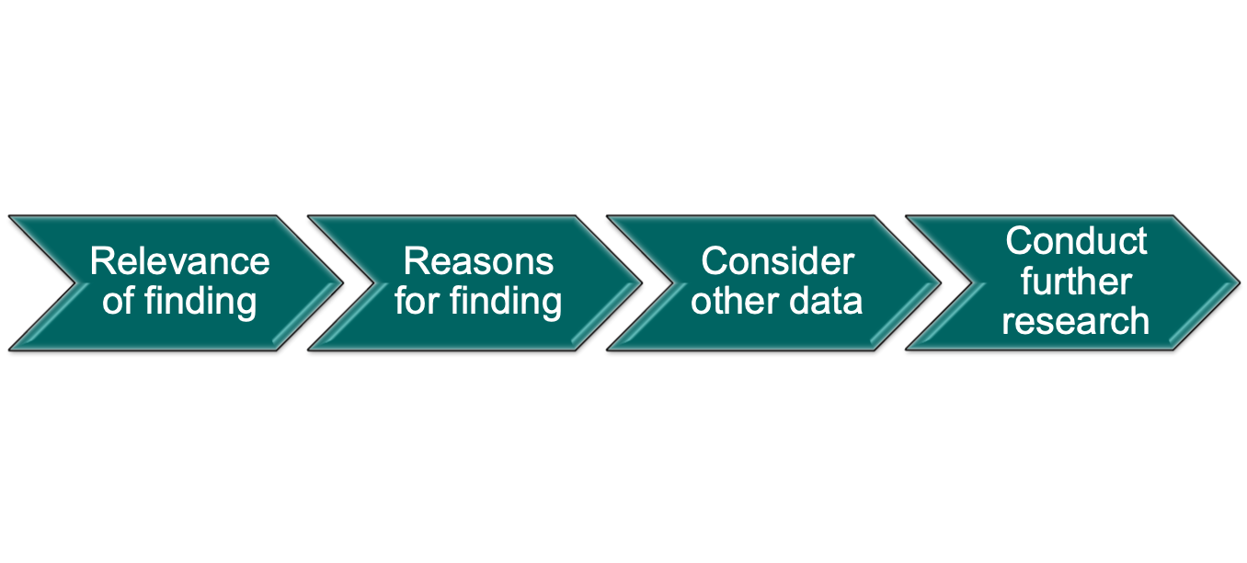
Interpretation – other data sources
Situation analyses
Demographic and health surveys
Performance improvement data
Notes:
Other data sources include:
NOTE to facilitator: Read slide.

Slide 39
Interpretation – conduct further research
Data gap conduct further research
Methodology depends on questions being asked and resources available
Notes:
Once you review additional data, it may become apparent that these data are not sufficient to explain the reasons for your findings – that a data gap exists. In these instances, it may be necessary to conduct further research.
The types of research designs that are applied will depend on the questions that need to be answered, and of course will be tempered by the feasibility and expense involved with obtaining the new data.

Slide 40
Key messages
Use the right graph for the right data
Tables – can display a large amount of data
Graphs/charts – visual, easier to detect patterns
Label the components of your graphic
Interpreting data adds meaning by making connections and comparisons to program
Service data are good at tracking progress & identifying concerns – do not show causality
Notes:
We have come to the end of the module on Data Presentation and Interpretation. The key messages of this module include:
NOTE to facilitator: Read slide.

Slide 41
Activity: Calculating coverage and retention
Notes:
In this small group work session, you will have the opportunity to practice analysis, presentation, and interpretation.

Slide 42
Learning Objectives
Use basic statistics to measure coverage and retention
Develop graphs that display performance measures (utilization, trends)
Interpret performance measures for programmatic decision making
Notes:
By the end of this session, the learner will:
NOTE to facilitator: Read slide.

Slide 43
Small group activity
Form groups of 4–6
Each group reviews 2 worksheets from Excel file and answers the questions (1 hr 45 min)
Each group presents 2 findings from each worksheet, focusing on the programmatic relevance of the findings (10 min per group)
Audience provides feedback on analysis and interpretation (notes errors, additional interpretation) (10 min per group)
Notes:
NOTE to facilitator: Assign two worksheets per group. Participants should spend 1 hour and 45 minutes answering the questions on the worksheets. Remind participants after 50 minutes that they should begin working on their second worksheet to ensure that they have adequate time to address both worksheets.
After 1 hour 45 minutes, ask participants to present their results. Each group will be given about 10 minutes for its presentation. Then spend 10 minutes discussing the presentation with the larger group. The plenary (or facilitator) should point out errors or inaccuracies and provide feedback on how to better analyze, interpret, or present the information.

